Slide 1
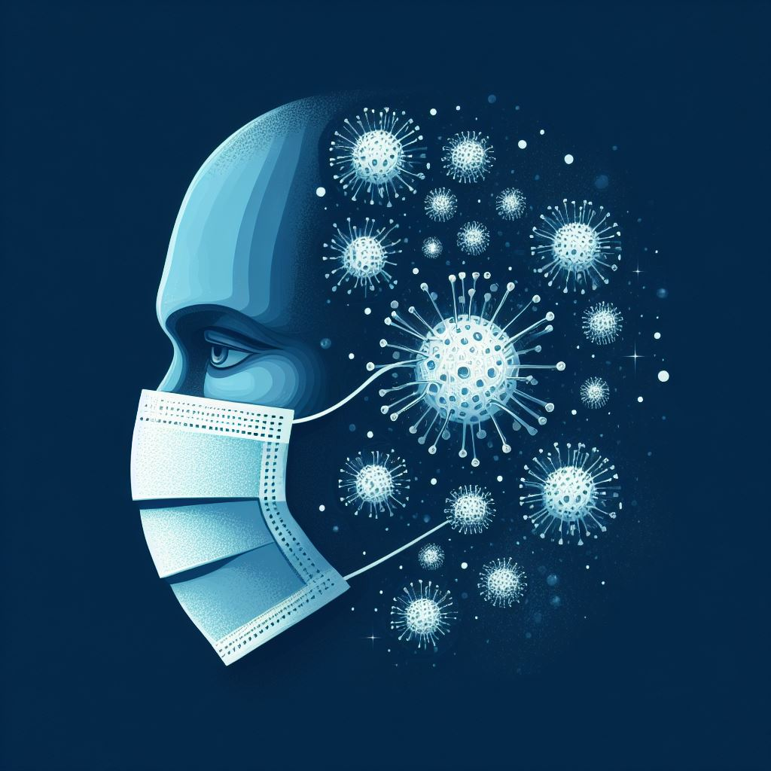
A NOVEL FACE MASK DETECTION MODEL FOR THE COVID-19 PANDEMIC
D.NAGA RAJENDRA 4TH YEAR CSE-A 20N71A0518

Slide 2

Overview
Background
Project overview
Architecture
Cost
Schedule
Financial benefit

Slide 3
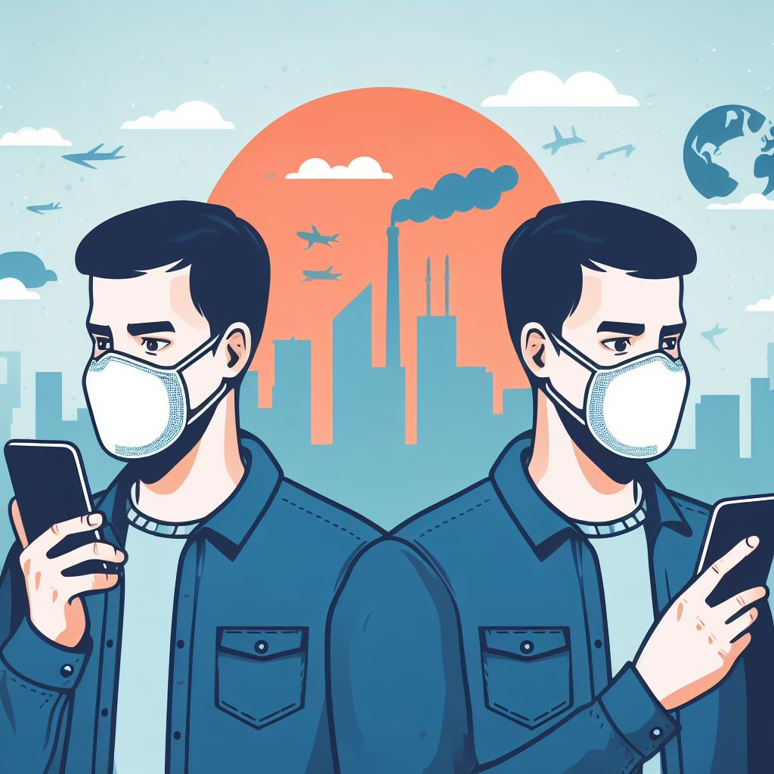
BACKGROUND
The trend of wearing face masks in public is rising due to the COVID-19 coronavirus epidemic all over the world. Before COVID-19, people used to wear masks to protect their health from air pollution. But people are now using it for both.

Slide 4

Project Overview
So our topic is to detect people wearing mask or not and if they are wearing a mask then it is to detect if they are wearing mask correctly or not and we are going to be doing using machine learning. And to train this model we are going to be using some datasets like RMFD(Real-World Masked Face Detection), SMFD(Simulated Masked Face Detection), LFW(Labeled Faces in the Wild).
And to test our model we will be using some methods like SVM(Support Vector Machine), Decision Tree, Ensemble.

Slide 5
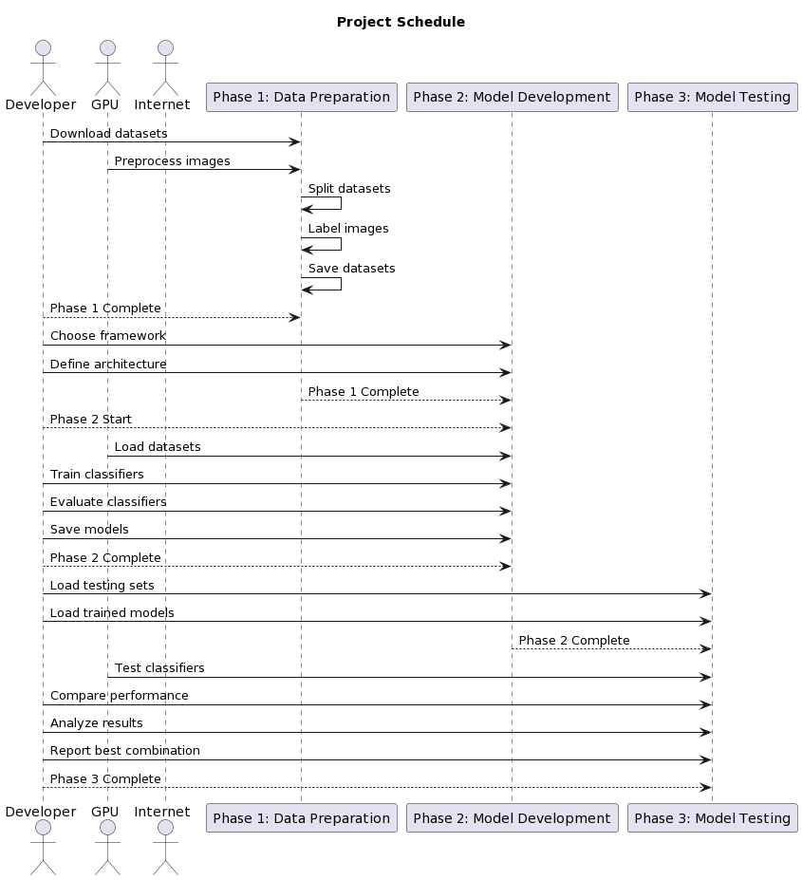
Architecture

Slide 6

COCOMO(Constructive Cost Model)
Estimated LOC(Lines Of Code):
Phase 1 (Data Preparation): 1000 LOC
Phase 2 (Model Development): 3000 LOC
Phase 3 (Model Testing): 1500 LOC
The formula for effort in COCOOMO:
Effort (E) = a * (LOC)^b * EAF
Where EAF is Effort Adjustment Factor and a, b are constants. Here we are taking Nominal complexity then the typical values of a=2.8, b=1.2.
Calculating for each phase:
Phase 1 Effort (Data Preparation): E1 = 2.8 * (1000)^1.2 * 1.0 ≈ 3284 person-months
Phase 2 Effort (Model Development): E2 = 2.8 * (3000)^1.2 * 1.0 ≈ 14747 person-months
Phase 3 Effort (Model Testing): E3 = 2.8 * (1500)^1.2 * 1.0 ≈ 4820 person-months
The required time for each phase is:
Phase-1: 1-2 weeks Total Duration:
Phase-2: 2-4 weeks 4-8 weeks
Phase-3: 1-2 weeks

Slide 7
COST
Estimated cost for each phase:
Phase 1: Data Preparation
Duration: 1-2 weeks (Let's assume 1.5 weeks for calculation)
Resources: A computer with sufficient storage space and an internet connection
Cost estimation:
Determine the hourly rate for each team member based on Indian standards (e.g., ₹700 per hour).
Calculate the total personnel cost: 1.5 weeks * 40 hours/week * ₹700/hour (per team member).
Add any minor expenses (e.g., data storage costs, internet expenses) based on Indian market rates.
Phase 2: Model Development
Duration: 2-4 weeks (Let's assume 3 weeks for calculation)
Resources: A computer with a GPU or a cloud service with GPU support
Cost estimation:
Determine the hourly rate for each team member based on Indian standards (e.g., ₹900 per hour due to specialized skills).
Calculate the total personnel cost: 3 weeks * 40 hours/week * ₹900/hour (per team member).
Include expenses for GPU usage (if applicable) or cloud service costs based on Indian market rates.
Phase 3: Model Testing
Duration: 1-2 weeks (Let's assume 1.5 weeks for calculation)
Resources: A computer with a GPU or a cloud service with GPU support
Cost estimation:
Similar to Phase 2, determine the hourly rate for each team member based on Indian standards.
Calculate the total personnel cost: 1.5 weeks * 40 hours/week * ₹900/hour (per team member).
Include expenses for GPU usage or cloud service costs based on Indian market rates.

Slide 8
COST
Here we will be taking the server cost per month as ₹400\- and we will be doing this project in 3 months with 4 team members.
The total COST of all three phases for a single person:
Phase-1 + Phase-2 + Phase-3 = ₹ 2,10,400\-
For 4 persons it would be 2,10,400 x 4 = ₹8,41,600\-
Apart from these we also need to pay server bill, internet bill, current bill, etc., will be added as the estimated value of ₹30,000
The total COST estimate for whole process is ₹8,71,600\-

Slide 9

Schedule
Phase 1: Data preparation
Download the datasets from their respective sources.
Preprocess the images by resizing, cropping, and normalizing them.
Split the datasets into training, validation, and testing sets according to the given ratios (70%, 10%, 20%).
Label the images as with_mask or without_mask based on the presence of face masks.
Save the processed datasets in a suitable format (such as HDF5 or TFRecord) for later use.
Duration: 1-2 weeks
Resources: A computer with sufficient storage space and internet connection

Slide 10
Phase 2: Model development
Choose a suitable deep learning framework (such as TensorFlow or PyTorch) and a programming language (such as Python or C++) to implement the models.
Define the architecture and hyperparameters of each classifier (Decision trees, SVM, and Ensemble).
Load the training and validation sets from the processed datasets.
Train each classifier on each dataset (DS1, DS2, and DS3) separately using the appropriate loss function and optimizer.
Evaluate each classifier on the validation set using the appropriate metrics (such as accuracy, precision, recall, and F1-score).
Save the trained models and their weights in a suitable format (such as H5 or ONNX) for later use.
Duration: 2-4 weeks
Resources: A computer with a GPU or a cloud service with GPU support

Slide 11
Phase 3: Model testing
Load the testing sets from the processed datasets.
Load the trained models and their weights from the previous phase.
Test each classifier on each dataset (DS1, DS2, DS3, and DS4) separately using the same metrics as in the previous phase.
Compare the performance of each classifier on each dataset and analyze the results.
Report the best classifier and dataset combination for face mask detection based on the results.
Duration: 1-2 weeks
Resources: A computer with a GPU or a cloud service with GPU support

Slide 12

Financial Benefit
In brief, developing a face mask detection system can provide financial benefits through:
Cost Reduction: Lower healthcare costs and reduced labor expenses in settings like retail, hospitality, and public transportation.
Business Efficiency: Increased customer confidence and sales in retail and hospitality sectors, and sustained economic activity in various industries.
Public Safety: Revenue from fines for non-compliance with mask mandates and a safer environment for businesses.
Market Opportunities: Revenue from selling detection technology and custom solutions to various industries.
Data Insights: Monetizing data insights into customer behavior and preferences.
Competitive Advantage: Enhanced brand reputation for safety-conscious organizations.
Scalability: Potential for expansion and increased revenue streams.
It's important to perform a detailed cost-benefit analysis tailored to your project to quantify these financial benefits accurately.

